Slide 1
Welcome
to
my Presentation

Slide 2
Feni Computer Institute
Afroja Jainab
Instructor (Computer)
Dept: Telecommunication
Subject: Data Comunication & Networking (29443)
Semester: 4th

Slide 3
Chapter 03
Digital Communication System
Digital Modulation: provides more information capacity, high data security, quicker system availability with great quality communication. Hence, digital modulation techniques have a greater demand, for their capacity to convey larger amounts of data than analog modulation techniques

Slide 4
Kinds of Modulation:
1.Digital Modulation
2.Analog modulation
3.Line coding
4.Pulse Amplitude Midulation(PAM)
5.Pulse Code Modulation(PCM)
6. Delta Modulation(DM)
Digital Communication System With bolck diagram:

Slide 5
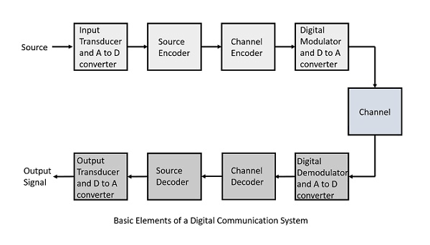

Slide 6
n a Digital Communication System, the messages generated by the source which are generally in analog form are converted to digital format and then transmitted. At the receiver end, the received digital data is converted back to analog form, which is an approximation of the original message [1]. A simple block diagram of a digital communication system is shown in Fig. 1.1

Slide 7
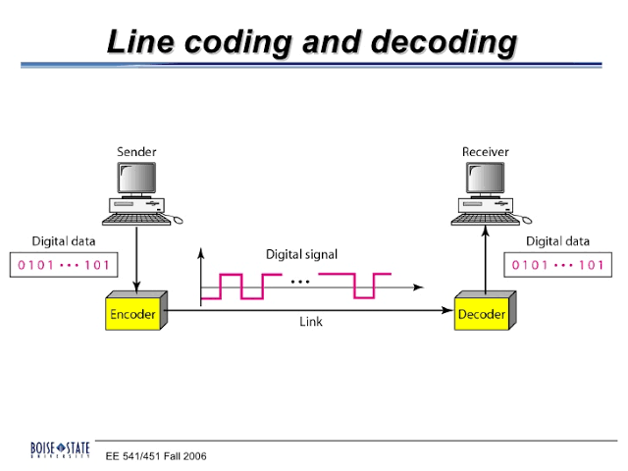
Line Coding: In telecommunication, a line code (also called digital baseband modulation, also called digital baseband transmission method) is a code chosen for use within a communications system for baseband transmission purposes. Line coding is often used for digital data transport.

Slide 8
Block Codi : helps in error detection and re-transmission of the signal. It is normally referred to as mB/nB coding as it replaces each m-bit data group with an n-bit data group (where n>m). Thus, its adds extra bits (redundancy bits) which helps in synchronization at receiver’s and sender’s end and also providing some kind of error detecting capability.
Block Coading are Three way
1.Division
2.Substitution
3.Line code

Slide 9
line Coding Shemes:
We can roughly divide line coding schemes into five categories:
1.Unipolar (eg. NRZ scheme).
2.Polar (eg. NRZ-L, NRZ-I, RZ, and Biphase – 3.Manchester and differential Manchester).
4.Bipolar (eg. AMI and Pseudoternary).
5.Multilevel
6.Multitransition

Slide 10
Non return to zero (NRZ) – It is unipolar line coding scheme in which positive voltage defines bit 1 and the zero voltage defines bit 0. Signal does not return to zero at the middle of the bit thus it is called NRZ. For example: Data = 10110.
But this scheme uses more power as compared to polar scheme to send one bit per unit line resistance. Moreover for continuous set of zeros or ones there will be self-synchronization and base line wandering problem.

Slide 11
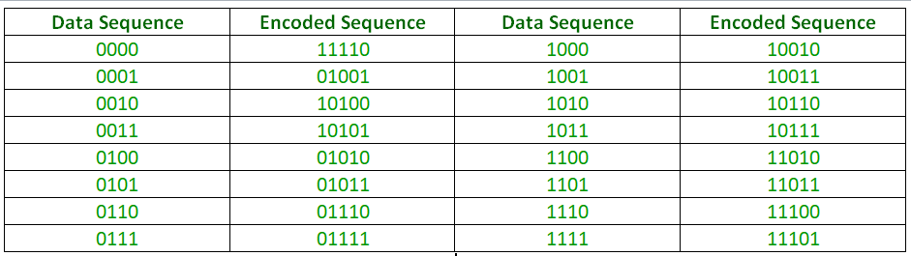
4B/5B (four binary/five binary ) –
This coding scheme is used in combination with NRZ-I. The problem with NRZ-I was that it has a synchronization problem for long sequences of zeros. So, to overcome it we substitute the bit stream from 4-bit to 5-bit data group before encoding it with NRZ-I. So that it does not have a long stream of zeros. The block-coded stream does not have more than three consecutive zeros (see encoding table)

Slide 12
FeedBack
review

Slide 13
Thank you

